Slide 1

CMDA Group 6
Andrew Koh, Jun Kim, Minahm Kim,
& Richard Howell

Slide 2
Executive Summary
Motivation: Research about vehicle attributes and their effects on efficiency to help determine which car is most efficient.
Goal + Result: Execute an analysis of vehicles to gain a greater understanding on the scope of performance and economic value.
Notes:
As graduating seniors, we wanted to research which car will best fit for us after graduation.

Slide 3
Data and Data Sources
Data: Statistics and Specifications on Cars produced in 1993
Data Source: Online repository of data sets compiled by user “vincentarelbundock”
Notes:
We used a dataset describing vehicles that were produced in 1993, containing information regarding make, model, engine and performance specifications, safety features, as well as general vehicle statistics.

Slide 4
Data Analytics and Interpretations
MPG City
MPG Highway
Fuel Tank Capacity
Airbags
Price

Slide 5
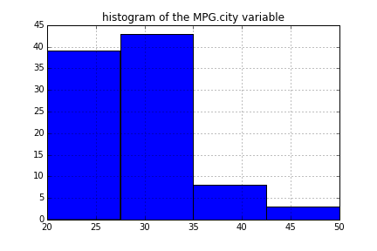
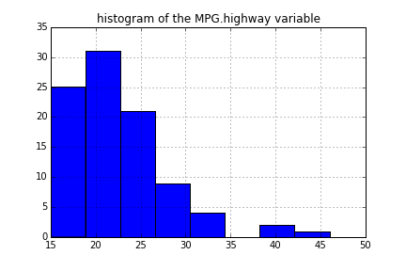
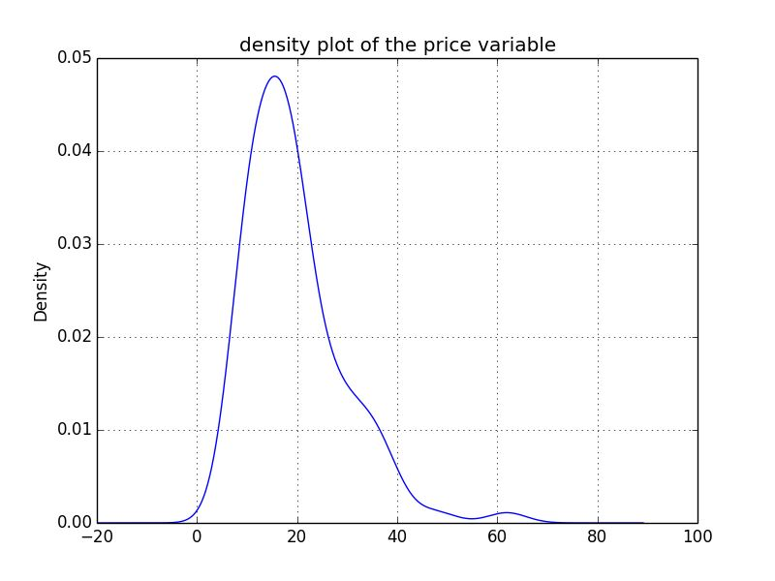
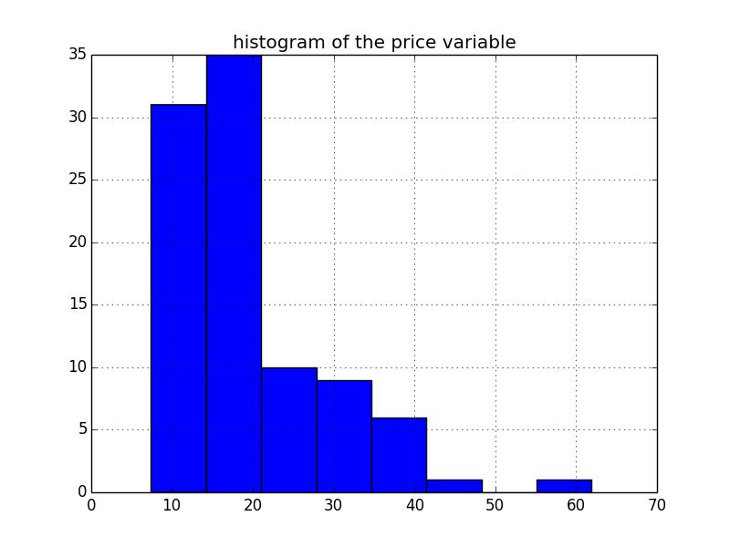
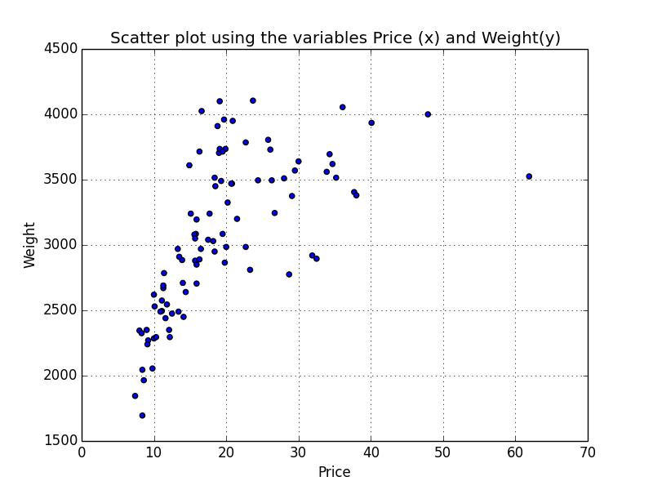
Visualizations and Discussion
Number of Vehicle
Price of Vehicle (US Dollar in Thousand)

Slide 6
Machine Learning Algorithm
Parameters
Number of cylinders
Engine Size
RPM
HorsePower
Weight
Revolutions per Mile
Prediction
Miles per Gallon Highway

Slide 7
Machine Learning Results
and Validation
Predict Highway Miles Per Gallon of Vehicles based on the number of cylinders, engine size, RPM, revolutions per mile, horsepower, and weight.
While examining the dataset, we saw correlations between Miles Per Gallon and certain categories.

Slide 8
Conclusions and Recommendations
for Deployment
Conclusions
Accuracy
Precision
Relativity
Recommendations
Drive a Prius
Notes:
Why a Prius?

